Slide 1
ExcelR Project P-34

Slide 2
Members:
1.Tanmoy Bhattacharya
2.Dipsikha Das
3.Swasthik Shetty
4.Ashish
5.Aslam Ashir

Slide 3
Stage 1: Defining Business Problem
Each Salesperson will be assigned with a
Target(no of products to be sold) for each
months. Which is given to them based on their
last month's Achievement(no of products sold)
i.e instead of simply giving 10% hike , we need to set a target for them for the next month.

Slide 4
Stage 2: Data Collection
Train Data set:
Dataset consist of 3 months data (last quarter) of 2019
with various features such as ‘products’, ’salesman_id’,
’month’, ‘year’, ‘Target’ and ‘Achievement’.
Test Data set:
Dataset consist of data for January 2020 with features

Slide 5
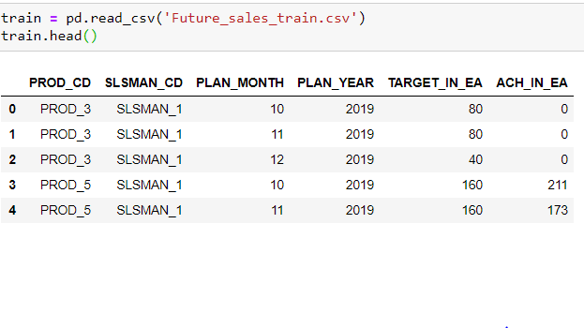

Slide 6
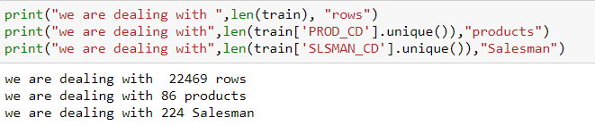

Slide 7
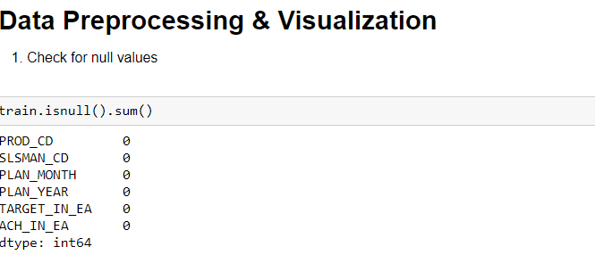

Slide 8
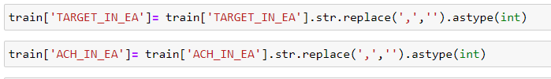
Float to integer value

Slide 9
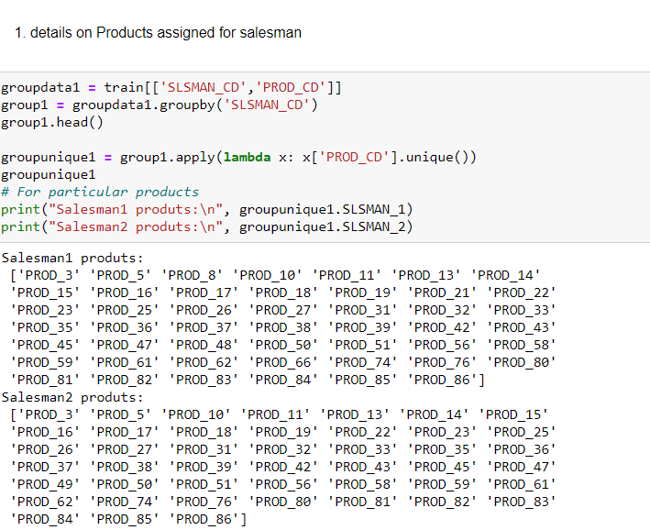
Grouping the columns

Slide 10
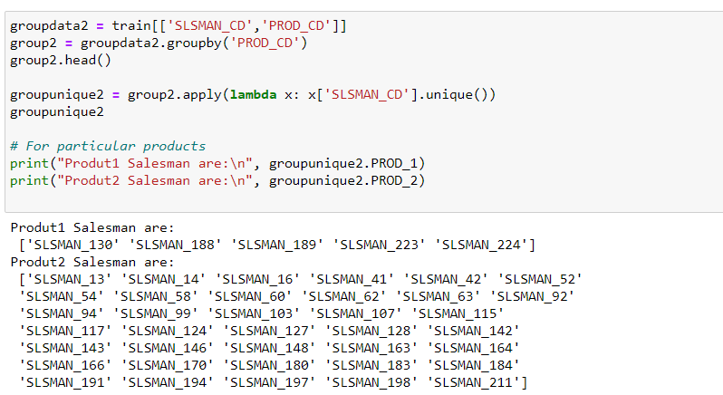
Salesman assigned for each product

Slide 11
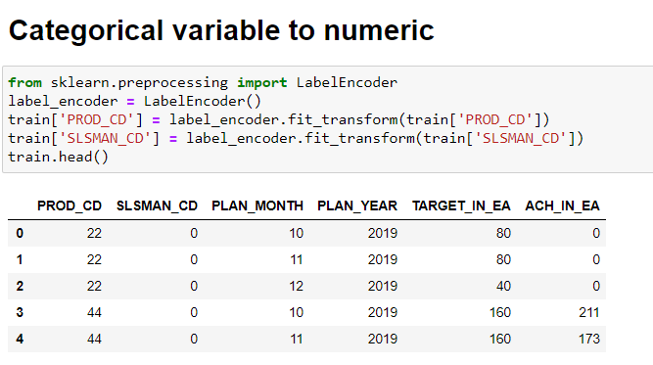
Categorical to integer value

Slide 12
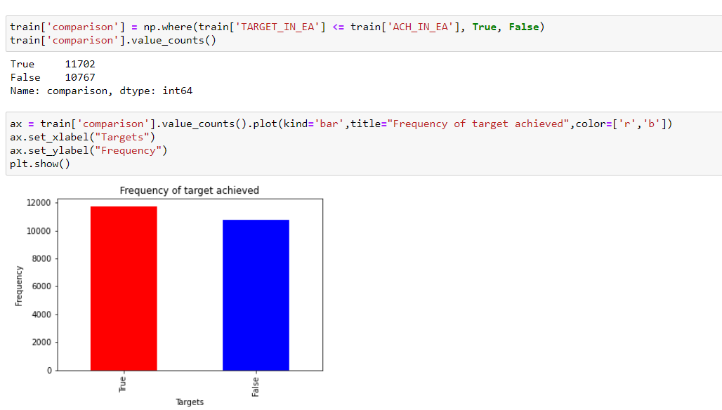
Counts of salesman meeting the target and not meeting the target

Slide 13
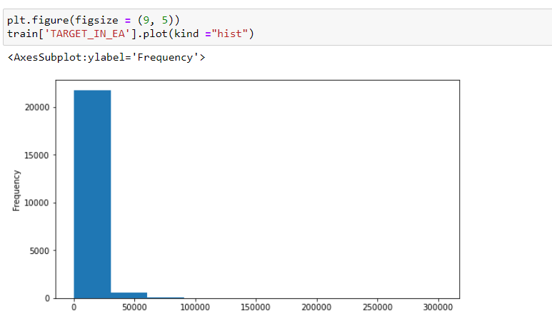
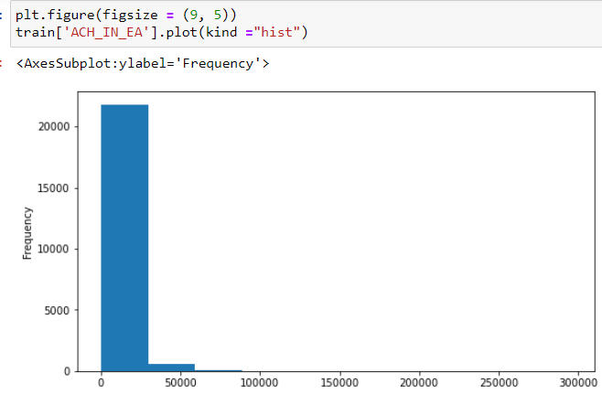
Checking normality distribution
Target column
Achieve column

Slide 14
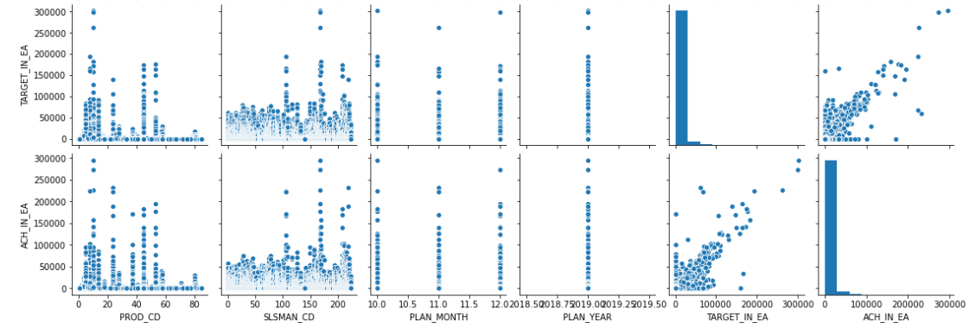
Pair plot

Slide 15
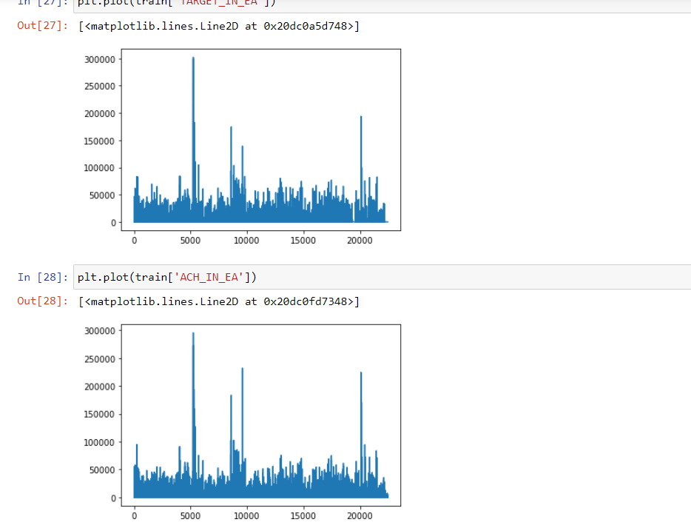
Plot of target and achieve

Slide 16
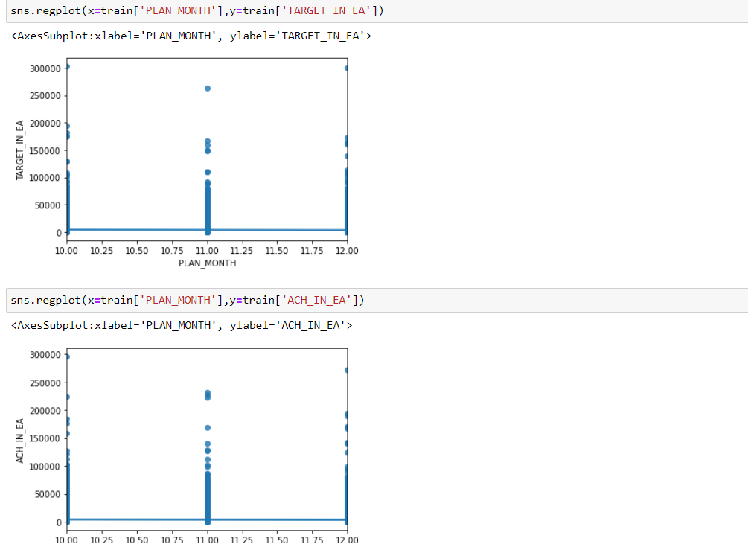
Reg plot

Slide 17
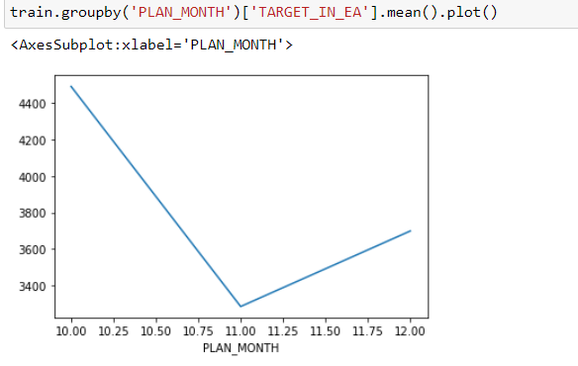
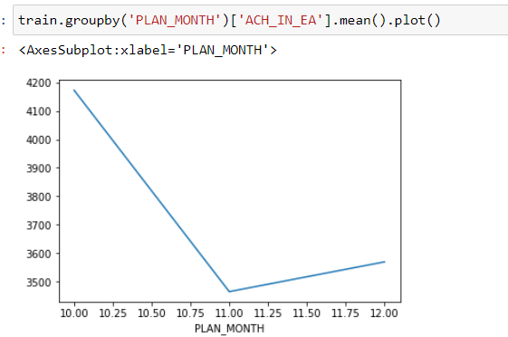
Grouping by the mean of target and achieve
target
achieve

Slide 18
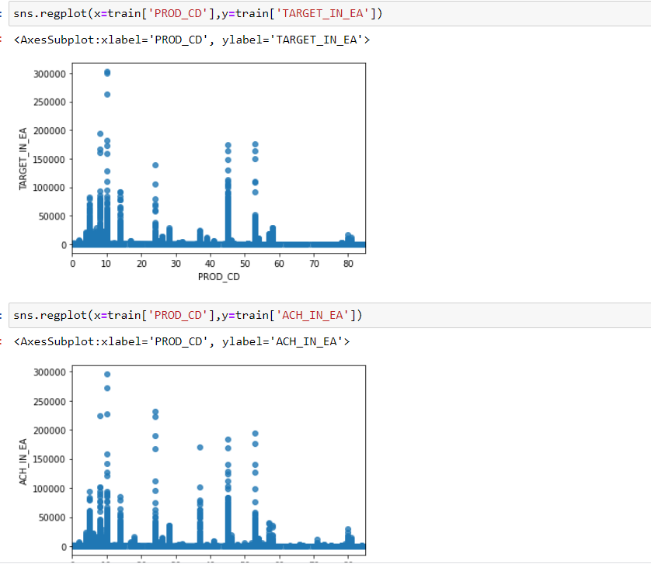
Reg plot of target and achieve with product

Slide 19
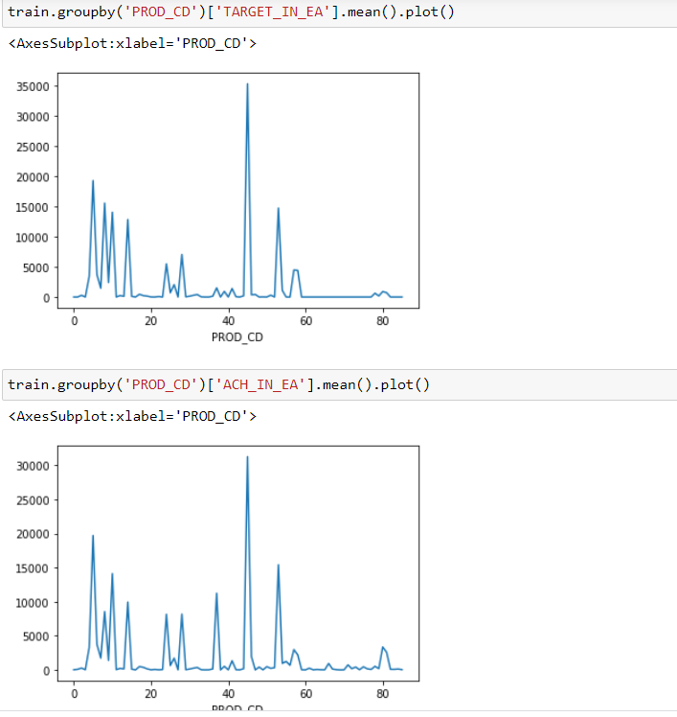
Group-by plotting of target and achieve with product

Slide 20
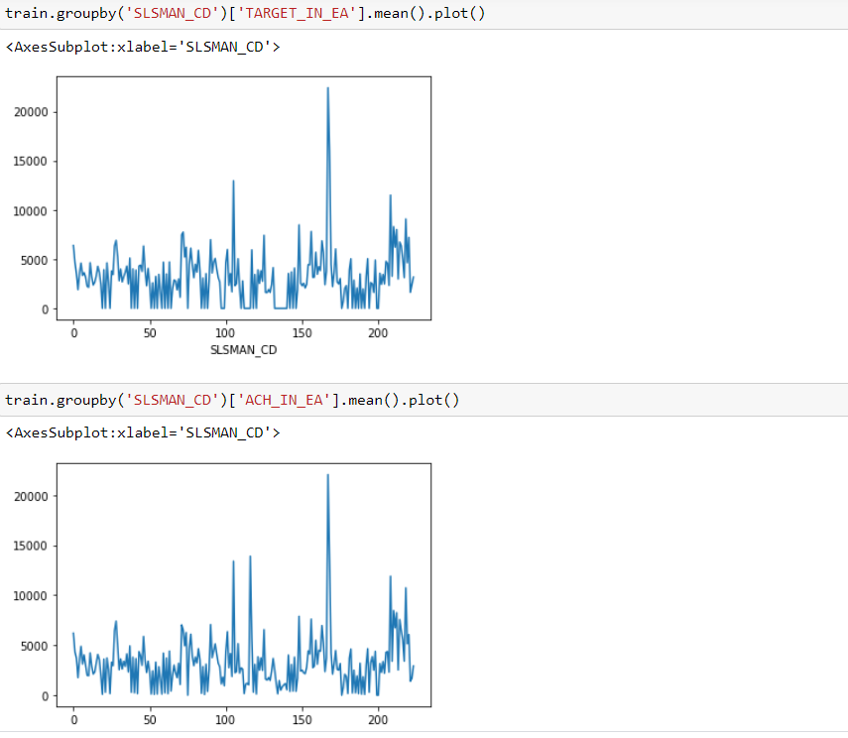
Group-by plot of target and achieve with salesman

Slide 21
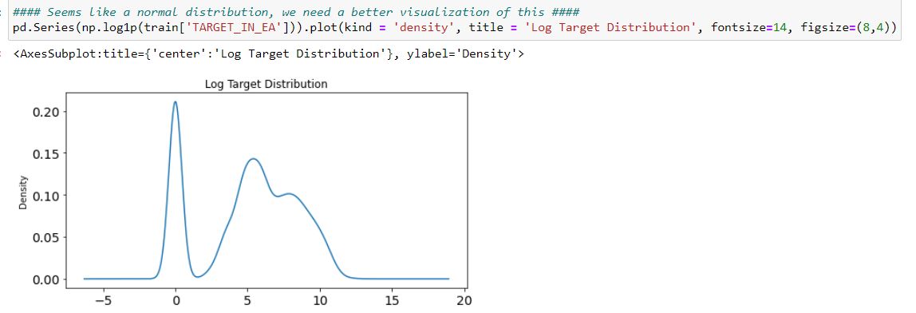
Log distribution of target

Slide 22
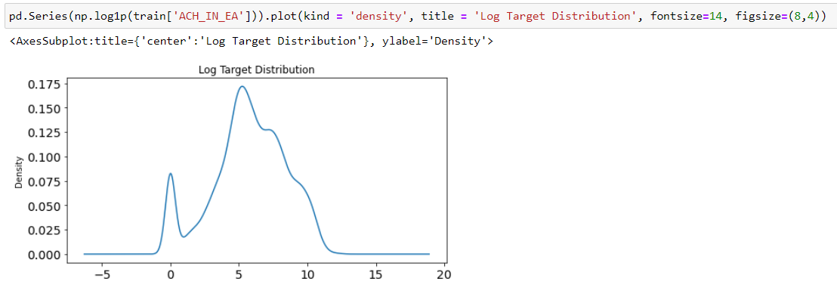
Log distribution of achieve

Slide 23
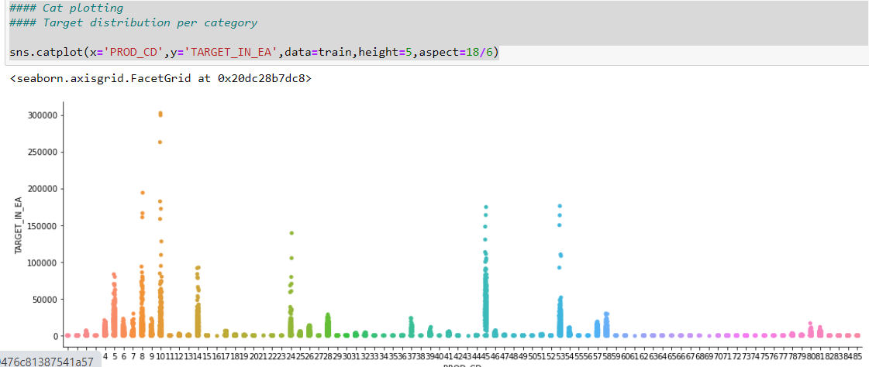
Cat-plot of target with product

Slide 24
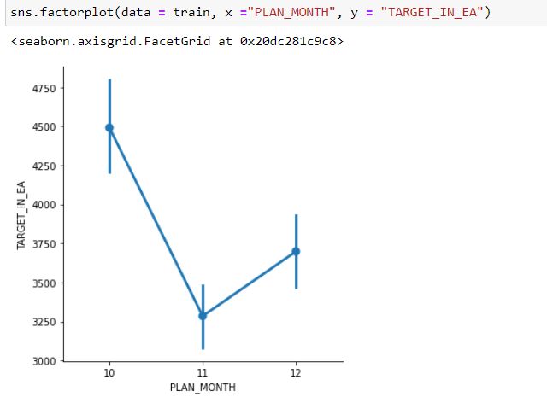
Factor-plot of plan month and target

Slide 25
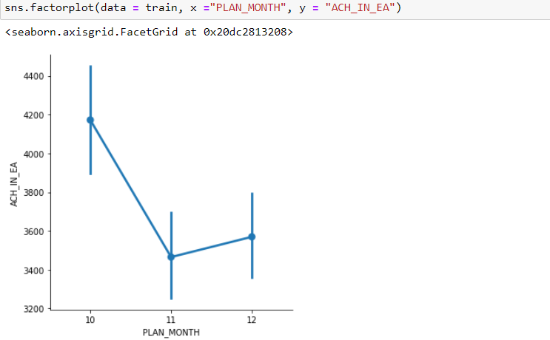
Factor plot of plan month and achieve

Slide 26
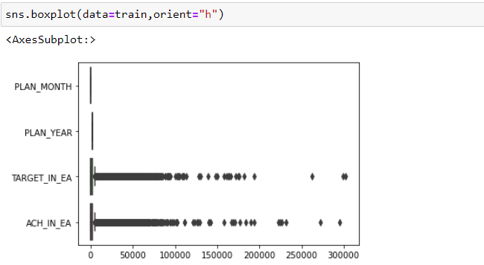
Box-plot for checking outliers

Slide 27
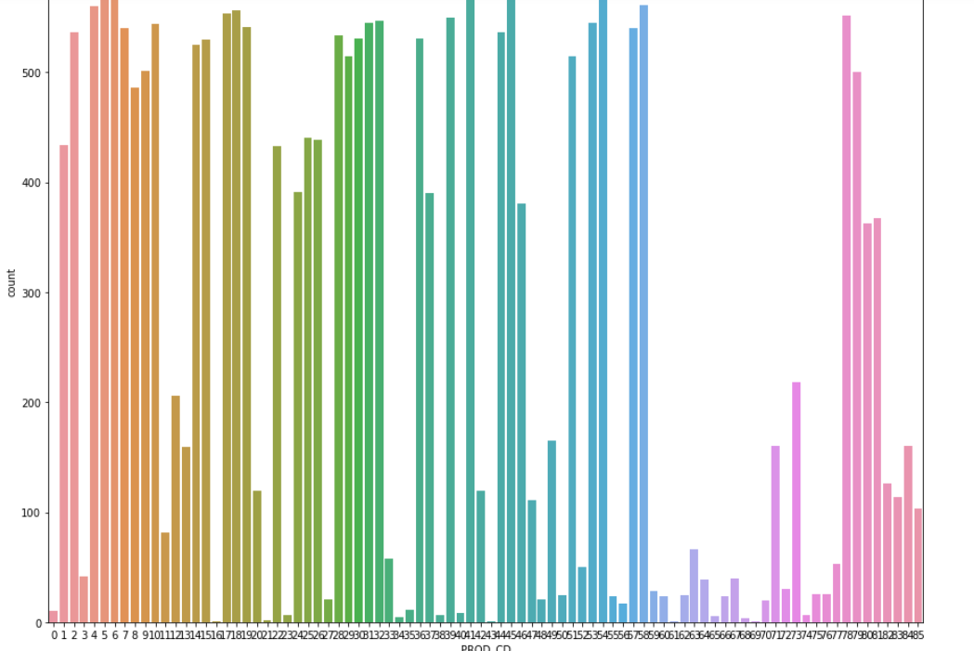
Catplot of frequency of product

Slide 28
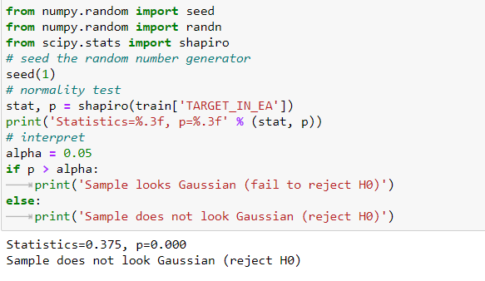
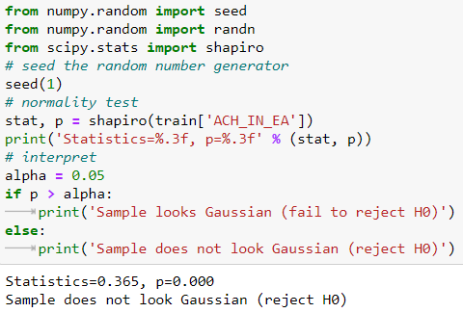
Statistical test of features
target
achieve

Slide 29
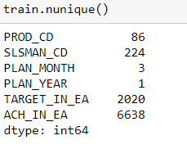
Unique value

Slide 30
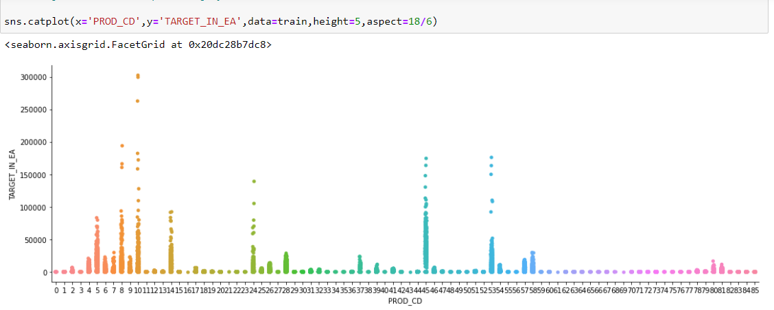
Catplot of product with target

Slide 31
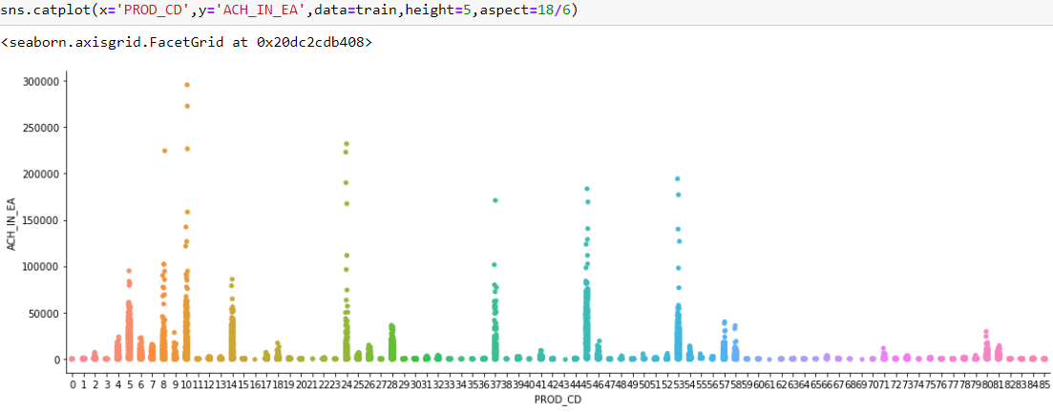
Catplot of product with achieve

Slide 32
Train test split of the data

Slide 33
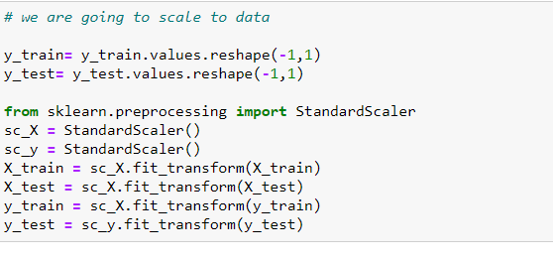
Feature scaling to standardized the data with mean =0 and standard deviation=1

Slide 34
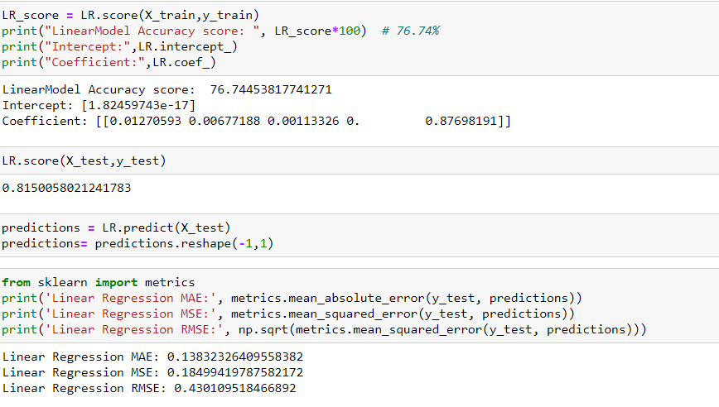
Linear regression accuracy score and loss function

Slide 35
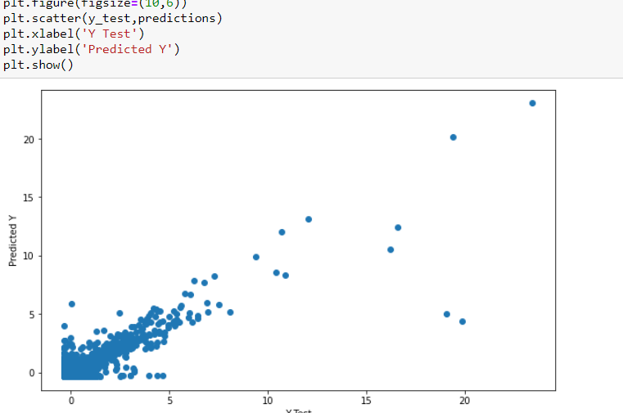
Plot of regression model

Slide 36
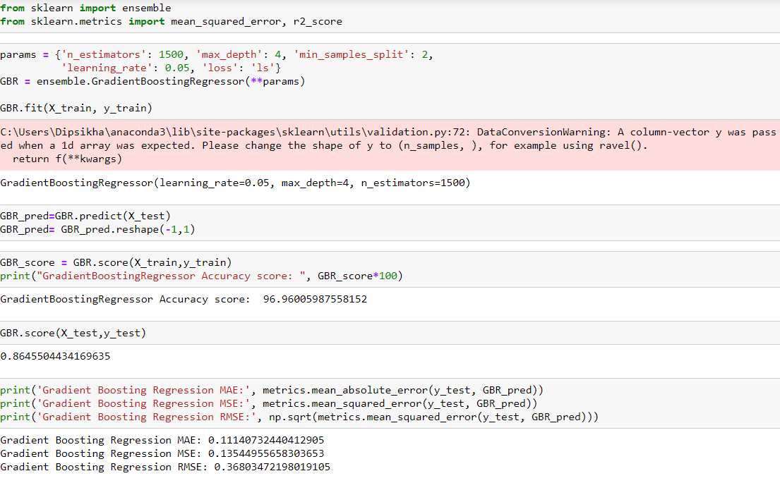
Gradient boosting accuracy and loss function

Slide 37
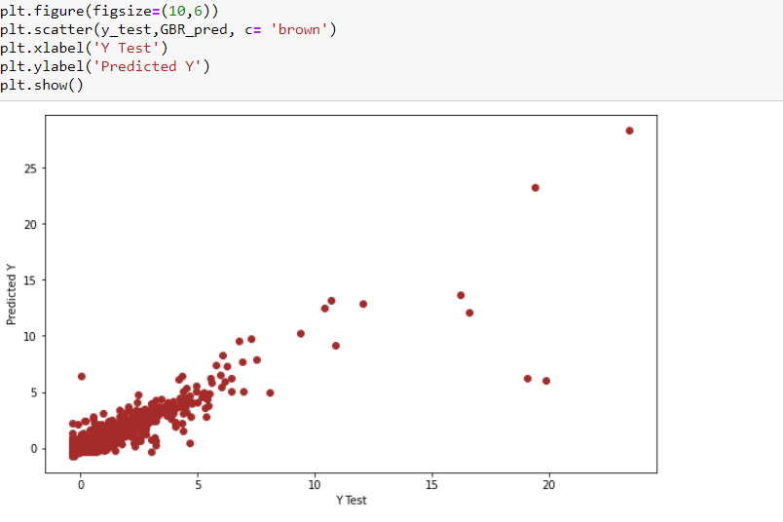
Plot of gradient boosting

Slide 38
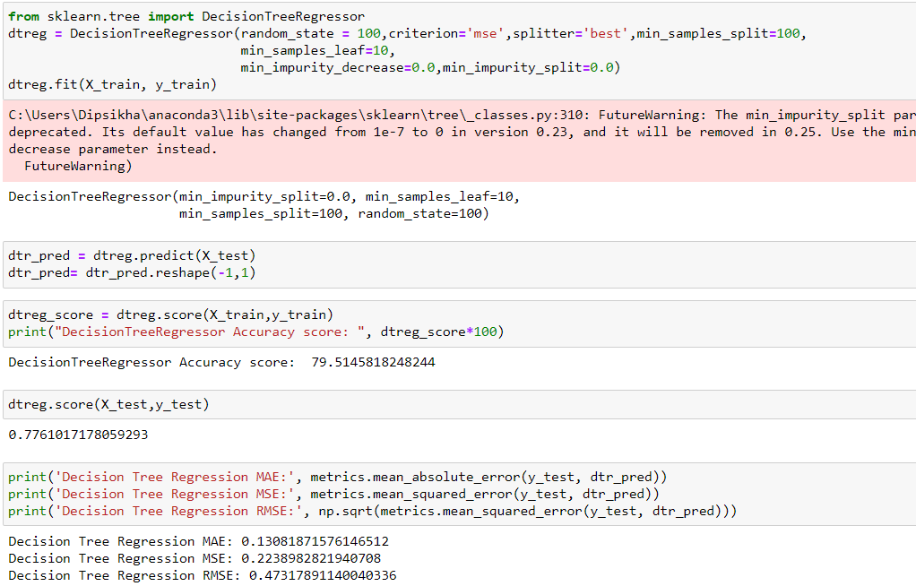
Decision tree accuracy and loss function

Slide 39
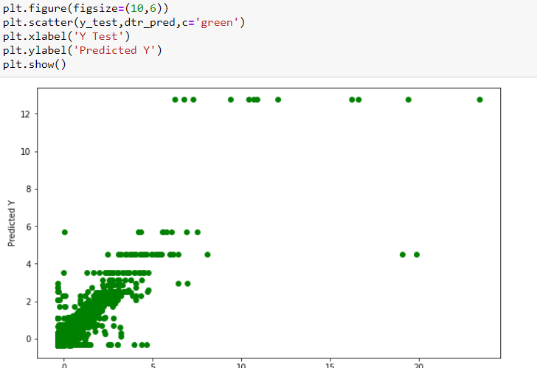
Decision tree plot

Slide 40
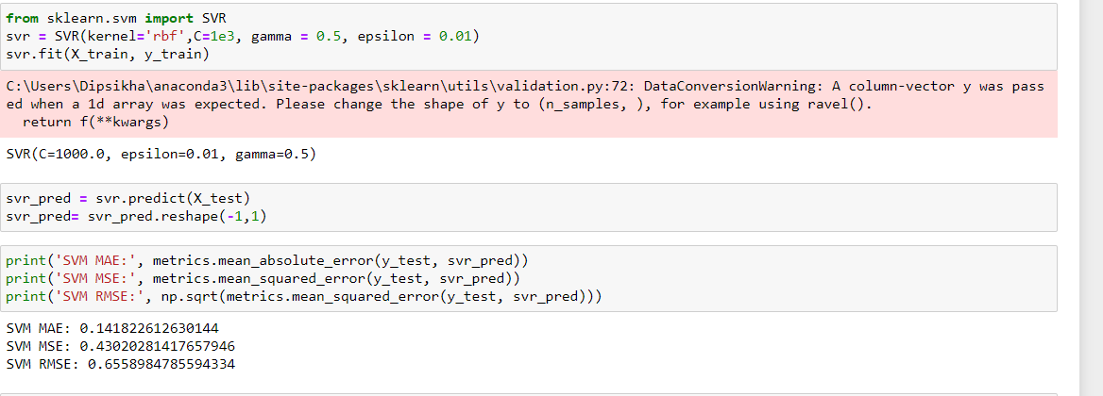
Support vector regressor

Slide 41
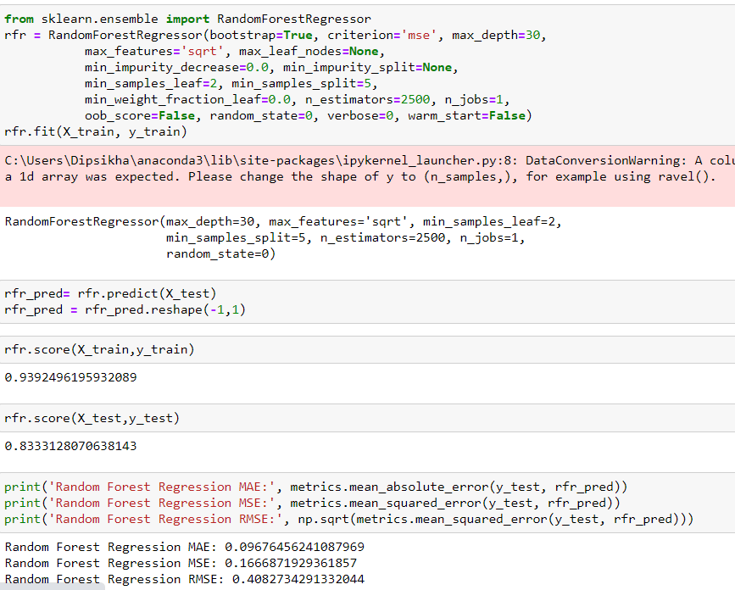
Random forest regressor

Slide 42
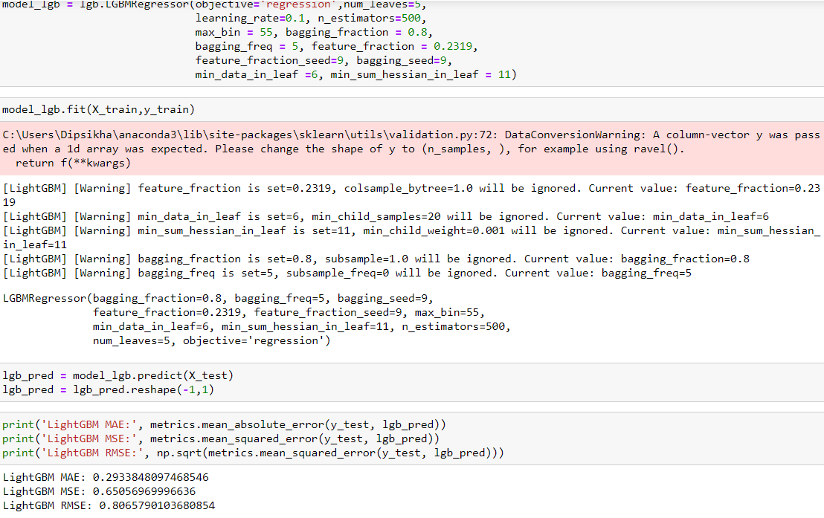
Lightgbm regressor

Slide 43
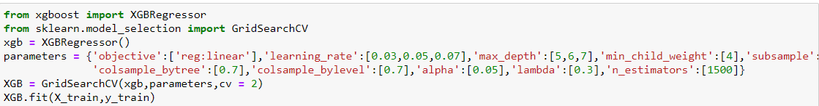
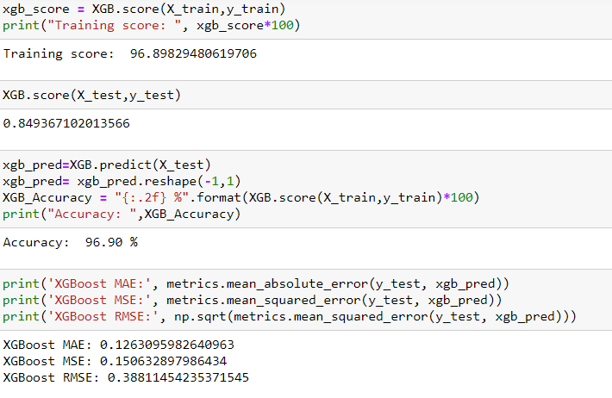
Xgboost regressor
code
Accuracy , loss function

Slide 44
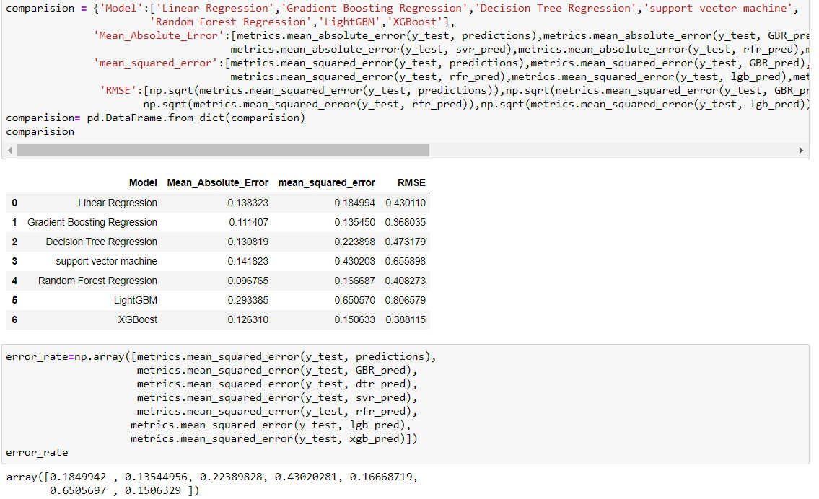
Error rate comparison

Slide 45
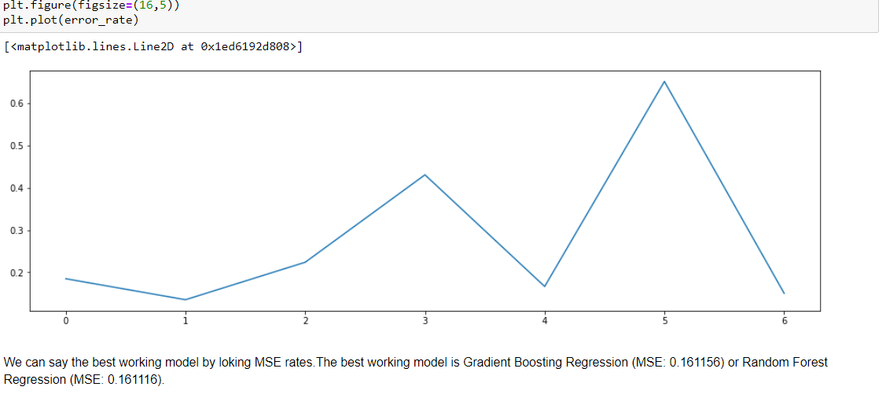
Error rate plot

Slide 46
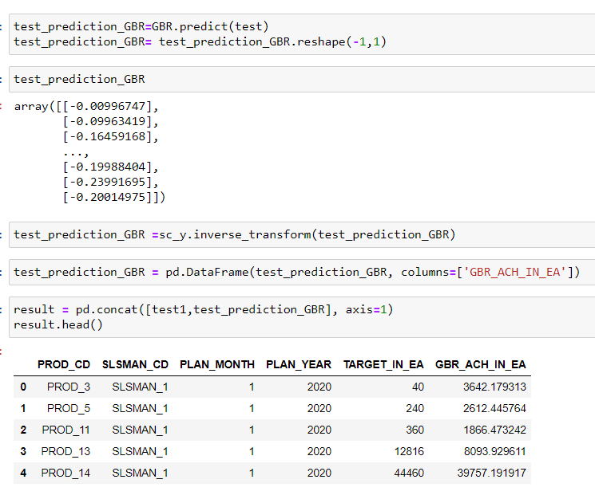
Predicting January achieve using gradient boosting regression

Slide 47
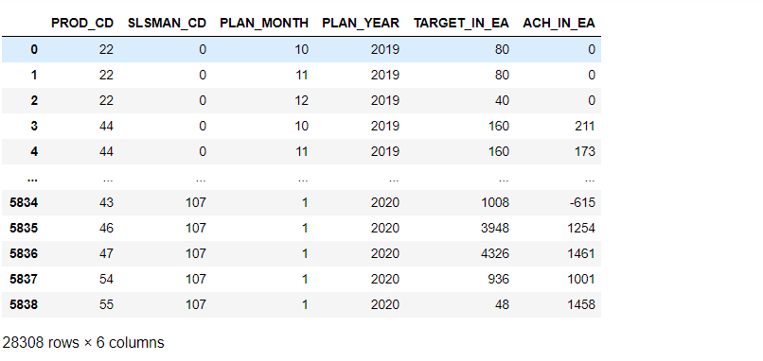
Concatenate both train and test data to get four months data together

Slide 48
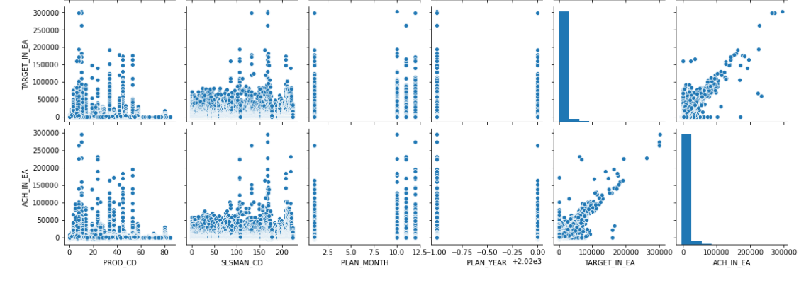
pairplot

Slide 49
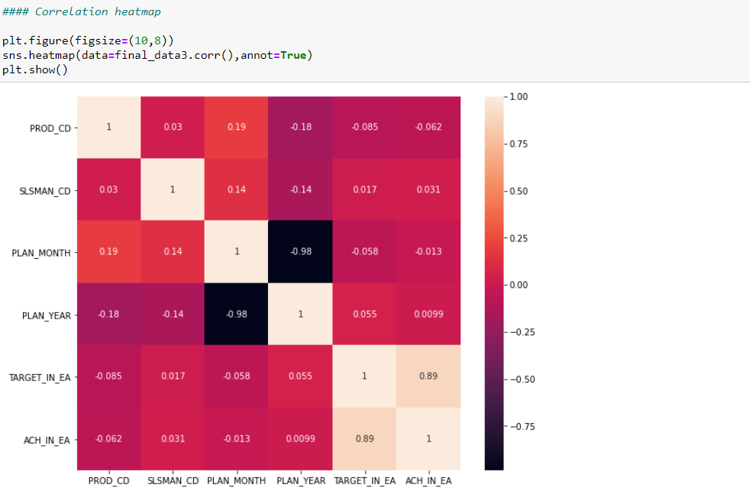
heatmap

Slide 50
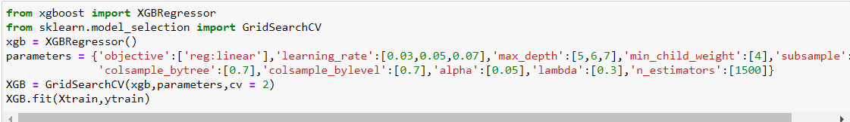
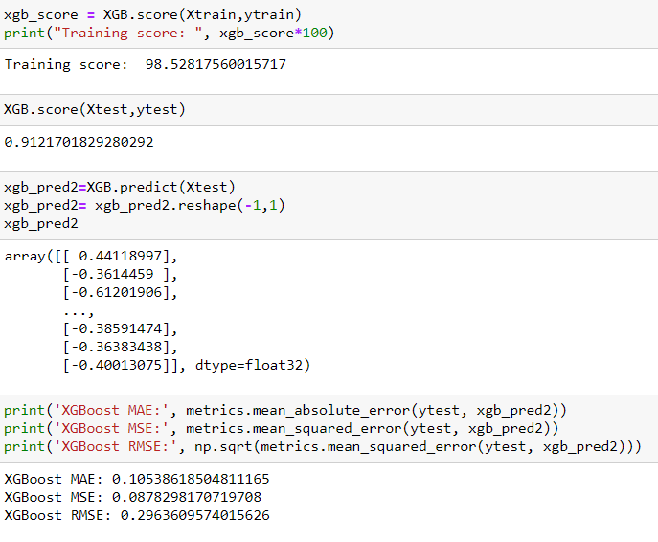
Xgboost regressor
code
Loss function and sccuracy

Slide 51

Randomforest regressor

Slide 52

Gradient boosting regressor

Slide 53

Error comparison

Slide 54

Error plot

Slide 55

Pickle file of final xgboost model

Slide 56

.py file

Slide 57

Html file

